Slide 1
C. 1712 — 1824
ENGINE BEFORE THEORY
SYNTHETICS — RESIDENCY PITCH
The engine ran for a century
before the theory.
~112
useful mystery → routine industry
years between Newcomen's atmospheric engine and Carnot's Réflexions.
Refrigeration, systematic engine design, entire industries nobody had been able to imagine.
Synthetics. Gerard McCaul — Astera residency application
01 / 06
Notes:
A heat engine was in serious industrial use for about a century before anyone had a theory of what it was doing. Before Carnot and Clausius, the engine was a useful mystery — you could build one, and if you were careful and lucky, it worked. After the theory, refrigeration, systematic engine design, and whole industries nobody had been able to imagine became routine. The theory did not invent the engine; it made the engine legible, and then it made everything downstream of the engine possible.

Slide 2
THE CLAIM
We are here again.
Intelligence engines exist and work. A physical theory of them does not.
■ WHAT EXISTS
□ WHAT IS MISSING
The engines.
A theory of them.
Biological brains. Deep networks. Neuromorphic chips. We build them, operate them, and depend on them — at ruinous energetic cost.
A principled account of what an intelligence is, what it costs, and what any given physical substrate can efficiently do.
—
They work.
—
No Carnot bound.
—
We have empirical scaling laws.
—
No closure criterion.
—
We do not know why they work.
—
No substrate-independent accounting.
Synthetics.
02 / 06
Notes:
My claim is that we are today in an exactly analogous situation with intelligence. Intelligence engines exist and work — biological brains, deep networks, the machinery of modern AI. But a principled physical theory of what they are, what they cost, and what any given substrate can efficiently do, does not. We are the mechanics before the physicists. Synthetics is my attempt at that theory.

Slide 3
THE FOUNDATIONS ARE ALREADY WRITTEN
Two pre-preprints, one static skeleton.
The residency extends both into dynamics, connects them formally, and applies them to neuromorphic computing.
gmccaul.co.uk/physics.html #pre-preprints
DRAFTS
Pre-preprints
In-progress drafts of a foundational document for a broader program concerned with a physical theory of representations.
The Cost of Complexity
Equilibrium from the Inside Out
G. McCaul
G. McCaul
In-progress draft
Exact Hamiltonian of Mean Force · In-progress draft
Derives, from three sparse assumptions, the thermodynamic cost of any embodied representation — and a sharp critical ceiling where the partition function becomes the Riemann zeta function.
An exact algebraic closure theorem: a criterion for when a subsystem of a larger physical system admits a compact local effective description — proved for a genuinely non-commuting case.
PDF →
PDF →
03 / 06
Notes:
Two foundational pre-preprints already lay the static mathematics. The Cost of Complexity derives, from three sparse assumptions, the thermodynamic price of any embodied representation — and identifies a sharp critical ceiling where the partition function becomes the Riemann zeta function. Equilibrium from the Inside Out gives an exact algebraic closure theorem — a criterion for when a subsystem admits a compact local effective description — proven for a genuinely non-commuting case. Both are currently static. The residency extends them into dynamics, connects them formally, and applies them to neuromorphic computing.

Slide 4
THE UNIFYING MOVE
One dynamics, many substrates.
Dynamical systems theory is the glue: biological, quantum, and neuromorphic learners are three physical realisations of the same operator algebra. Embodiment then imposes constraints — and constraints are where design principles come from.
— BIOLOGY
— QUANTUM
— NEUROMORPHIC
Spiking cortex
Open-system evolution
Memristive reservoir
irregular spikes · sparse · cheap
coherent · non-commuting · lossy
analog state · hysteretic · embodied
— THE GLUE
A single operator-algebraic representation — the same linear evolution over a lifted observable space, whatever the hardware underneath.
∂t ρ = 𝓛[ρ]
CONSTRAINT · 01
CONSTRAINT · 02
Thermodynamic cost
Algebraic closure
Every embodied representation pays a price in free energy. The Cost of Complexity fixes that price from three sparse assumptions — and sets a critical ceiling.
Not every substrate admits a compact local description of what it does. Equilibrium from the Inside Out gives the exact criterion for when it does.
Synthetics.
04 / 06
Notes:
Here is the unifying move. Biological cortex, open quantum systems, and neuromorphic hardware look nothing like each other as physical objects, but they are all dynamical systems, and dynamical systems theory lets us write them all down as the same linear evolution over a lifted observable space — one operator algebra for all three. That shared representation is the glue. And the moment you insist these dynamics be physically embodied, two constraints fall out whether you want them to or not — a thermodynamic cost, and an algebraic closure criterion. Design principles for efficient intelligence are just what those constraints look like when you take them seriously. That is the shape of Synthetics.

Slide 5
EXPLICABILITY AS DELIVERABLE
Public writing is part of the work.
A synthesis which cannot be stated across the fields it unifies hasn't unified them.
ONGOING ESSAY PRACTICE
ESSAY PRIZE
Little Learning Machine
Spanspermia
Essays on physics, machine intelligence, and the occasionally unbearable nature of modern theory. Where Synthetics is drafted in public.
"Does Life Come from Outer Hilbert Space?" — an argument that informational structure, not chemistry, is the substrate question worth asking.
Substack — littlelearningmachine.substack.com
2nd place · FQxI Essay Competition
Synthetics.
05 / 06
Notes:
Alongside the mathematics, public writing is treated as part of the work rather than a separate communications activity. The argument is simple: a synthesis which cannot be stated across the fields it unifies has not unified them. Explicability is a research deliverable, not a chore. Little Learning Machine and the FQxI essay are where that work is already happening — second place out of several hundred entrants for an essay on whether life comes from outer Hilbert space.

Slide 6
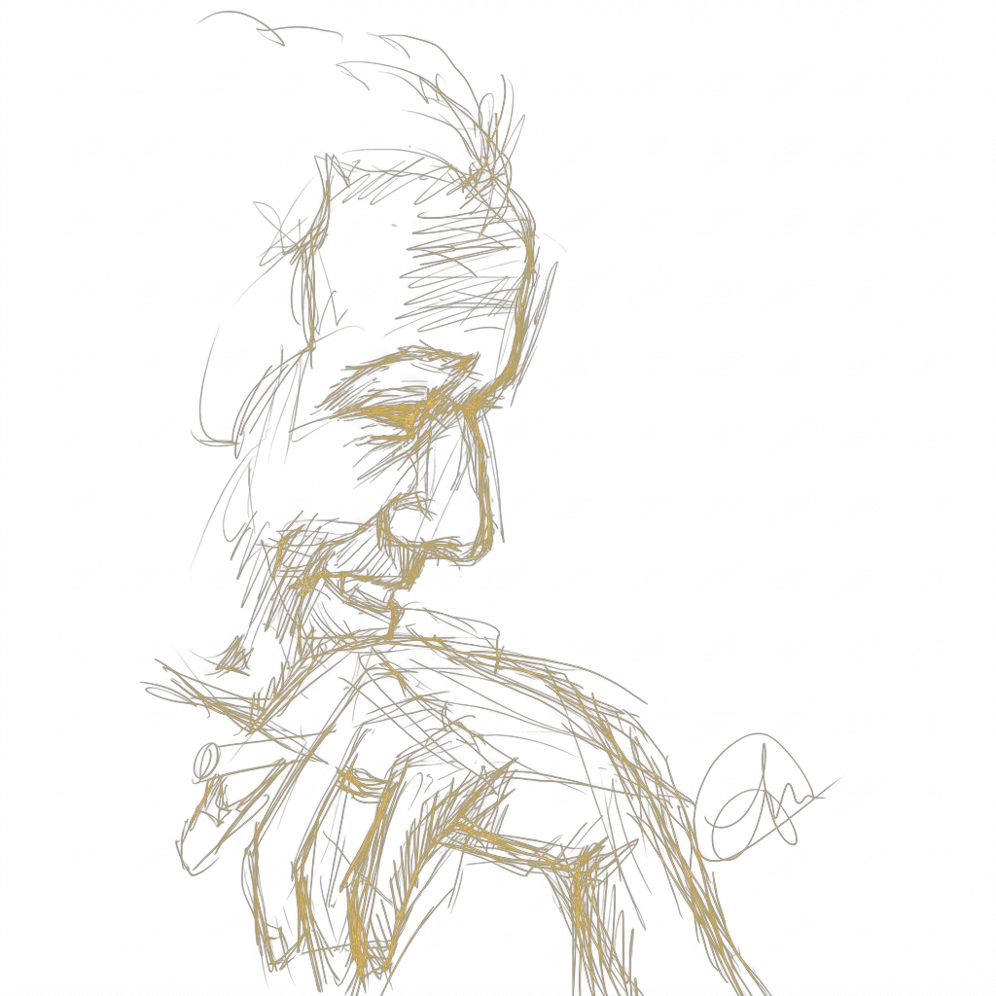
ABOUT
Gerard McCaul.
Theoretical physicist · Loose canon
I work at the intersection of quantum theory, thermodynamics, and machine intelligence — the three fields Synthetics proposes to unify. Twenty-five-plus papers across quantum control, open quantum systems, reservoir computing, superoscillations, and Koopman methods. I also write essays that are too long, and compose music that makes people wince.
PhD · King's College London, 2019 FQxI · 2nd place, 2024 Postdoctoral · Tulane
— THE APPLICANT
01 · PHYSICS
02 · ESSAYS
03 · WRITING
gmccaul.co.uk/physics.html
littlelearningmachine.substack.com
gmccaul.co.uk/writing.html
Gerard McCaul. Astera — Residency application · 2026
06 / 06
Notes:
A word on who's doing this. I'm a theoretical physicist — PhD King's, postdoc at Tulane — sitting at the intersection of the three fields Synthetics wants to unify: quantum theory, thermodynamics, and machine intelligence. Twenty-five-plus papers in quantum control, open systems, reservoir computing, superoscillations, Koopman methods. The website holds the full catalogue — the pre-preprints at slash physics, the essays on Substack, and the broader writing at slash writing. Thank you.

